Slide 1
Vaginal atrophy
Karen Garratt Urogynae CNS
March 2023

Slide 2
What is vaginal atrophy?
Vaginal atrophy (atrophic vaginitis) is thinning, drying and inflammation of the vaginal walls that may occur when your body has less estrogen. Vaginal atrophy occurs most often after menopause. For many women, vaginal atrophy not only makes intercourse painful but also leads to distressing urinary symptoms.

Slide 3
Causes of vaginal atrophy
go through the menopause
are breastfeeding
take contraceptive pills or antidepressants
have your womb removed (a hysterectomy)
have cancer treatments, such as chemotherapy
These things can cause a change in your hormone levels. This change can affect how much vaginal discharge or fluid you have.
You can also have vaginal dryness if you:
are not aroused during sex
use perfumed soaps, washes or douches in and around your vagina
have an underlying condition, such as diabetes or Sjögren's syndrome

Slide 4
Symptoms of vaginal atrophy
Vaginal discomfort
Vaginal dryness before/during sex
Pain during sex
Vaginal/vulval itching and/or burning
Thrush-like symptoms
Frequent urinary infections or sensations like urinary infection
Lack of bladder control

Slide 5
Treatments for vaginal atrophy
Replacing oestrogen directly to the vagina is considered the best way of reversing these symptoms.
Oestrogen applied internally to the vagina via cream, pessary or vagina ring delivers a small but highly effective dose of oestrogen - which will also improve bladder symptoms.
Non hormonal treatments are also very useful: eg Yes vaginal moisturiser

Slide 6
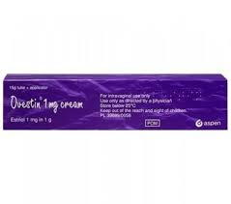
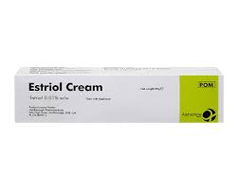
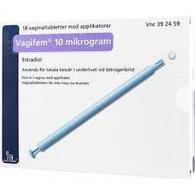
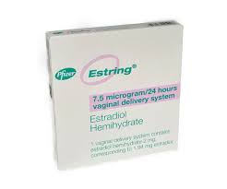
Vaginal oestrogen

Slide 7
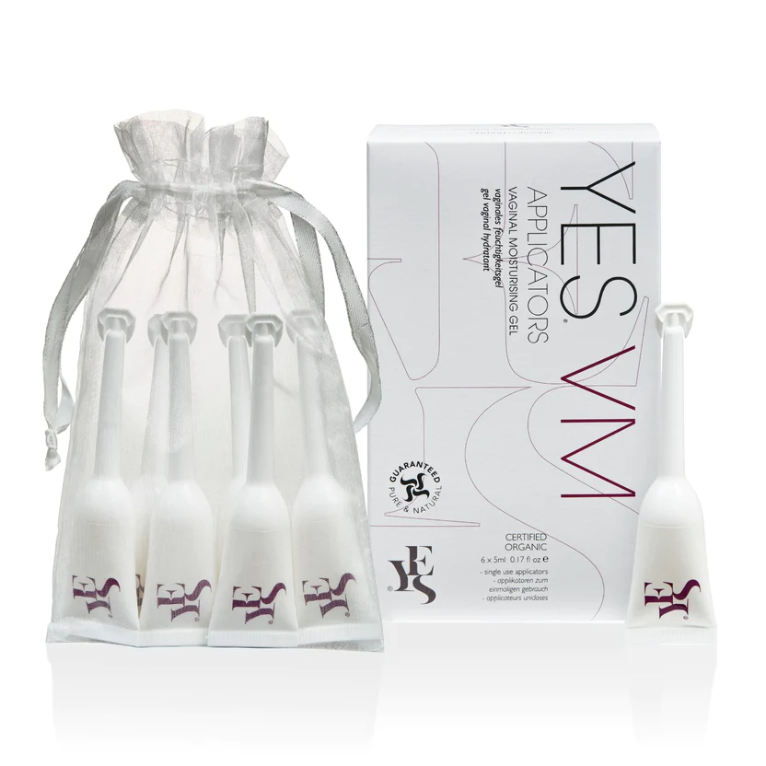
Non hormonal treatments

Slide 8
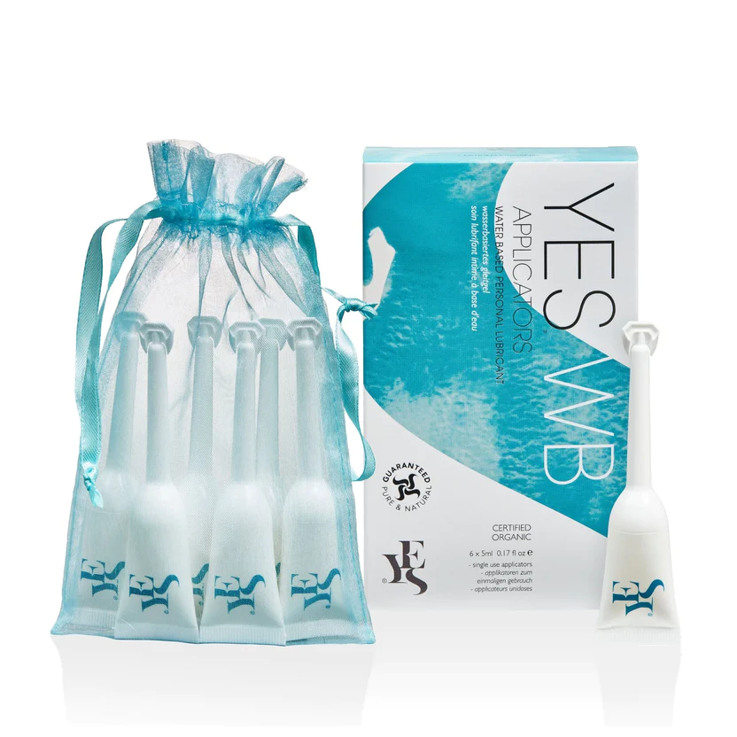

Slide 9
Useful links
www.yesyesyes.org/ for vaginal moisturiser and lubricants
www.thebms.org.uk British Menopause Society
If you would like further information please email me karen.garratt1@nhs.net

