Slide 1
Welcome to the Annual General Meeting
Tuesday 25 July 2023

Slide 2
AGM 2023 – Review of the Year
Dr George Findlay | Chief Executive Officer

Slide 3
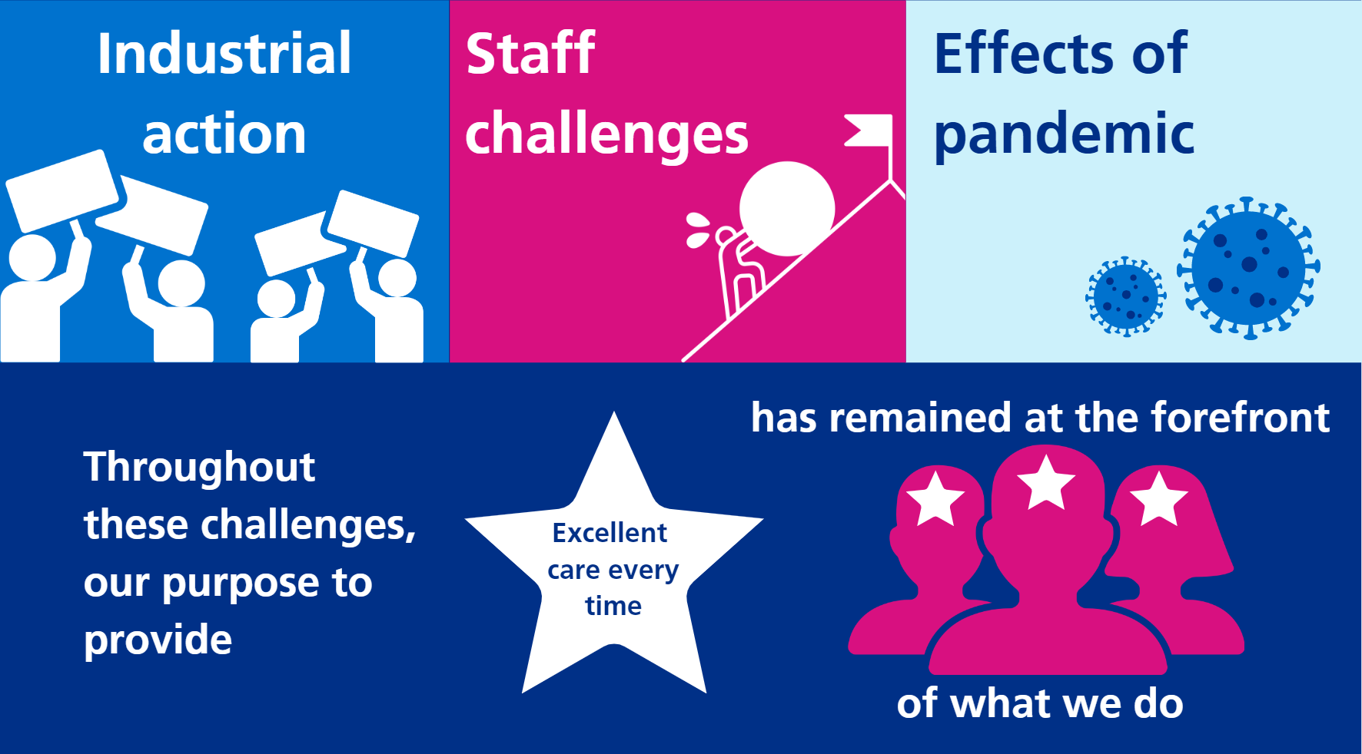
A year of challenges and success
Notes:
Context:
2022/23 proved a challenging year for all NHS organisations and UHSussex was no exception.
We have had a very difficult winter, high demand for our services, staffing challenges, difficulties discharging medically ready patients to more appropriate care settings, and, the challenges of industrial action.
One thing that became clear is that even throughout these challenges, our purpose has continued - to provide excellent care every time for the patients who are first and foremost in all our thinking.
We aim to do that through our commitment to continuous improvement – by being an organisation where better never stops, always focused on the True North objectives that will keep us moving towards that goal.
So despite the difficulties of 2022/23, we had lots of success and achievements to be proud of

Slide 4
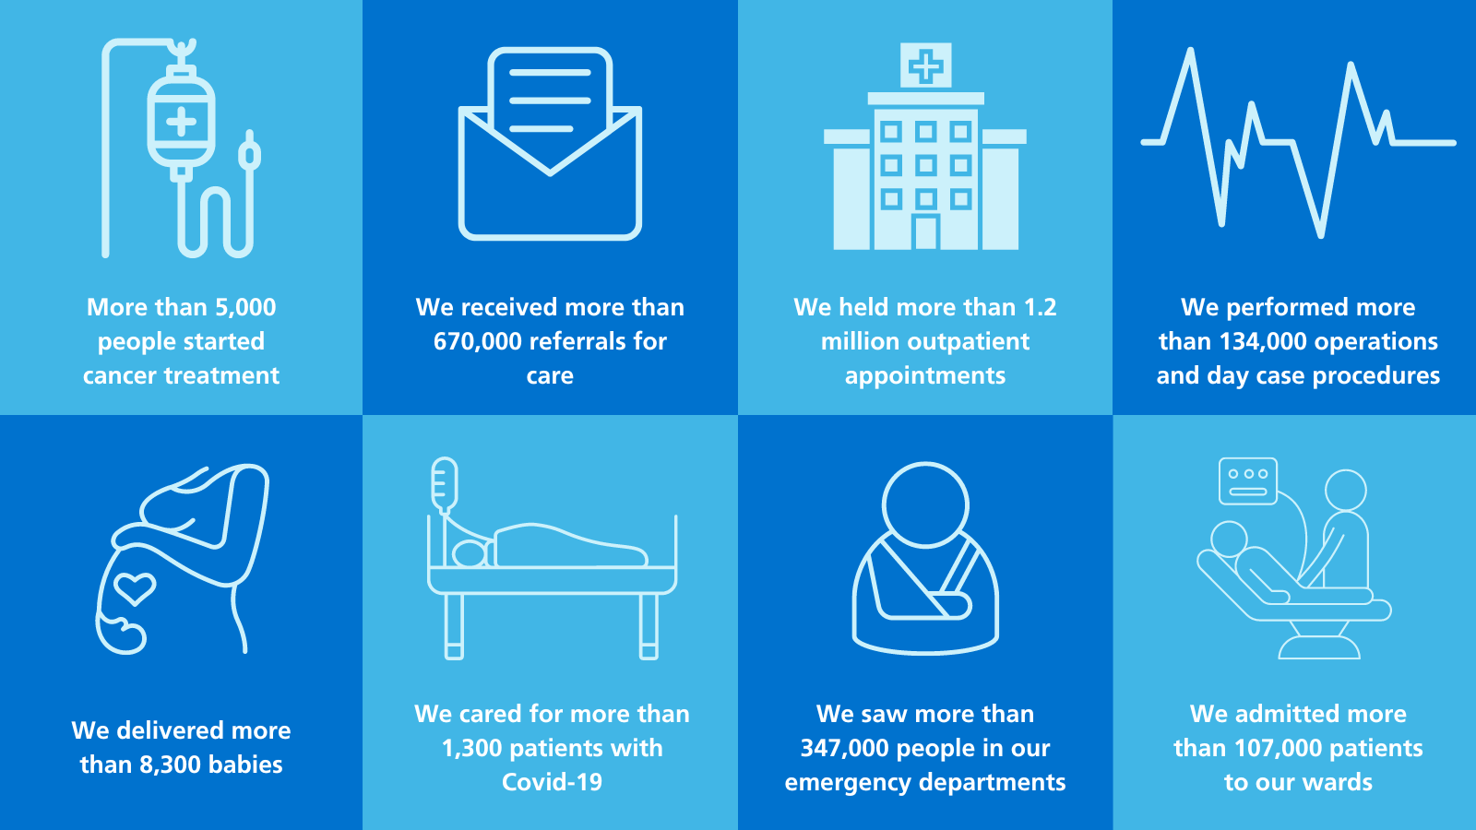
Our year in numbers
Notes:
In 2022/23:
• More than 5,000 people started cancer treatment (2021/22 5,500)
• We received more than 670,000 referrals for care (2021/22 420,000)
• We held more than 1.2 million outpatient appointments (2021/22 1.1 million)
• We performed more than 134,000 operations and day case procedures (2021/22 46,000)
• We delivered more than 8,300 babies (2021/22 8,500)
• We cared for more than 1,300 patients with Covid-19 (2021/22 3,500)
• We saw more than 347,000 people in our emergency departments (2021/22 320,000)
• We admitted more than 107,000 patients to our wards (2021/22 77,000)

Slide 5
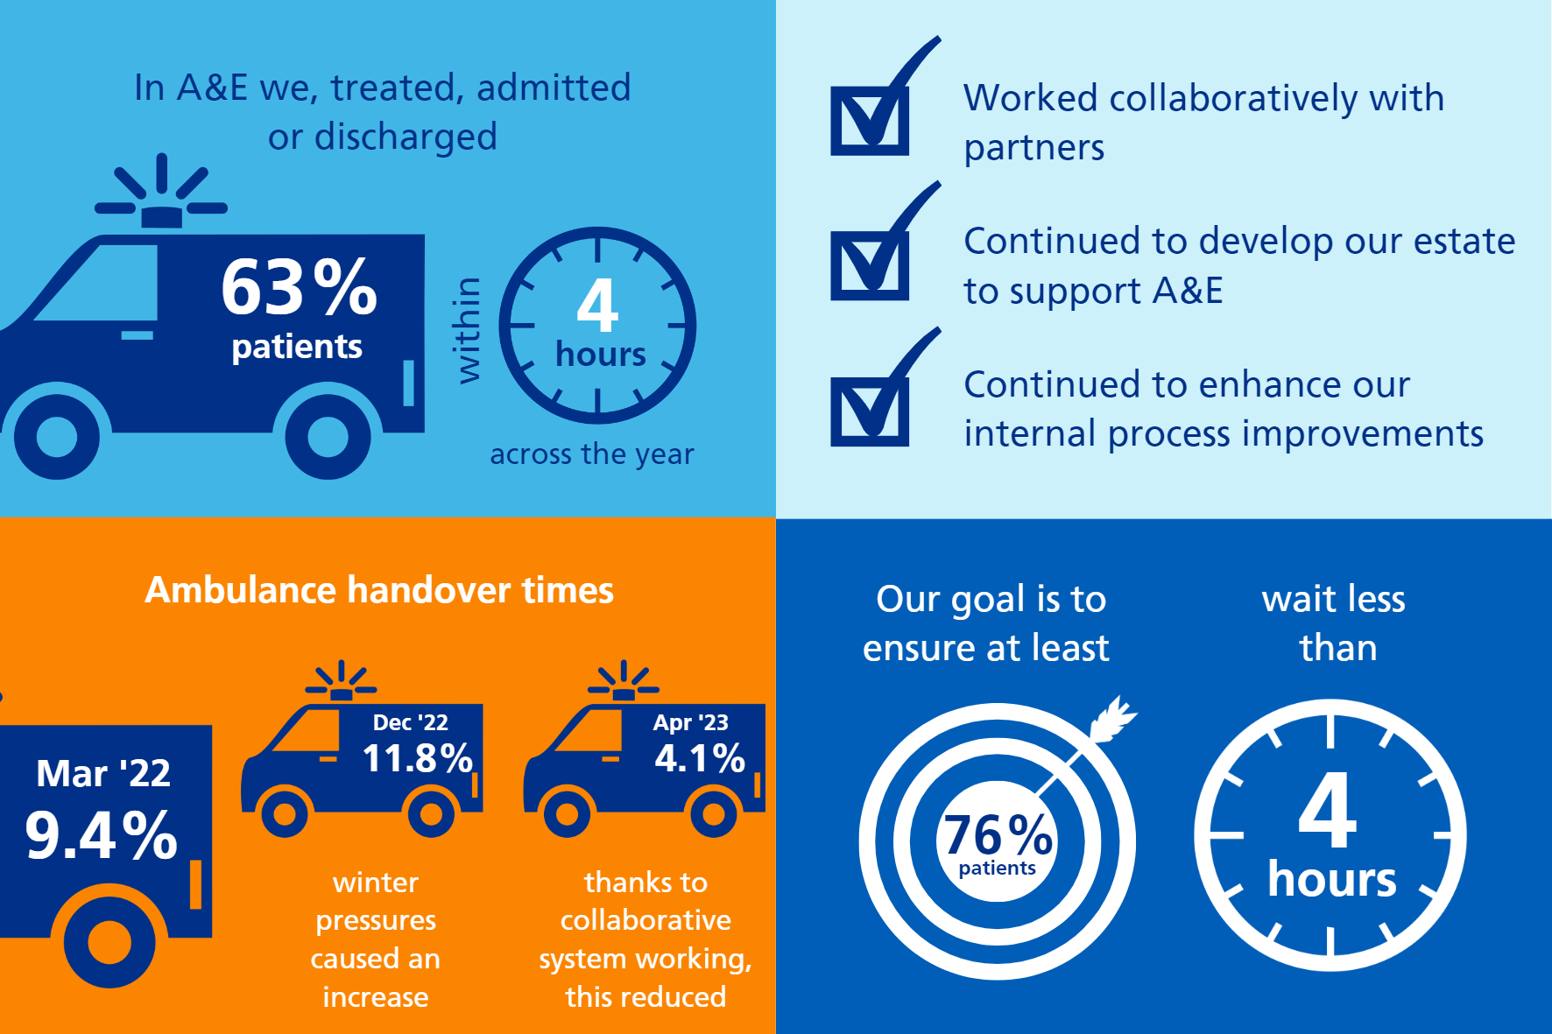
More timely access to urgent care
Patient experience
More patients rating their experience in A&E as good or very good.
March 2023
  WH 84%
  SRH 79%
  RSCH 82%
  PRH 91%
  RACH 85%
Aim for A&E waiting times
At least 76% of patients are waiting less than four hours to be treated, admitted or discharged from our emergency departments.
Notes:
In A&E we treated, admitted or discharged 63.4% of patients within 4 hours across the year, following significant flow constraints, and increased A&E demand.
We worked collaboratively with partners, continued to develop our estate to support A&E and continued to enhance our internal process improvements which will continue to mature and deliver improvements into 2023/24.
We improved our ambulance handover times
These improvements mean more patients are rating their experience in ED as good or very good.
Our goal now is to ensure at least 76% of patients across UHSussex wait less than four hours to be treated, discharged or admitted from our emergency departments.

Slide 6

Reducing waiting times for elective care
78-week waits
We treated 31,700 patients, who would have otherwise waited more than 78 weeks for treatment
By March 2023, we had fewer than 300 patients waiting more than 78 weeks for treatment
Aim
Ensure no patients are waiting more than 65 weeks by the end of March 2024
Notes:
Since March 2022, we’ve treated about 31,700 patients, who would have otherwise waited more than 78 weeks for treatment
By March 2023, we had fewer than 300 patients waiting more than 78 weeks for treatment
Non-elective pressures and industrial action have impacted this
Look ahead: We have now shifted focus and have plans to ensure that no patients are waiting more than 65 weeks by the end of March 2024.

Slide 7
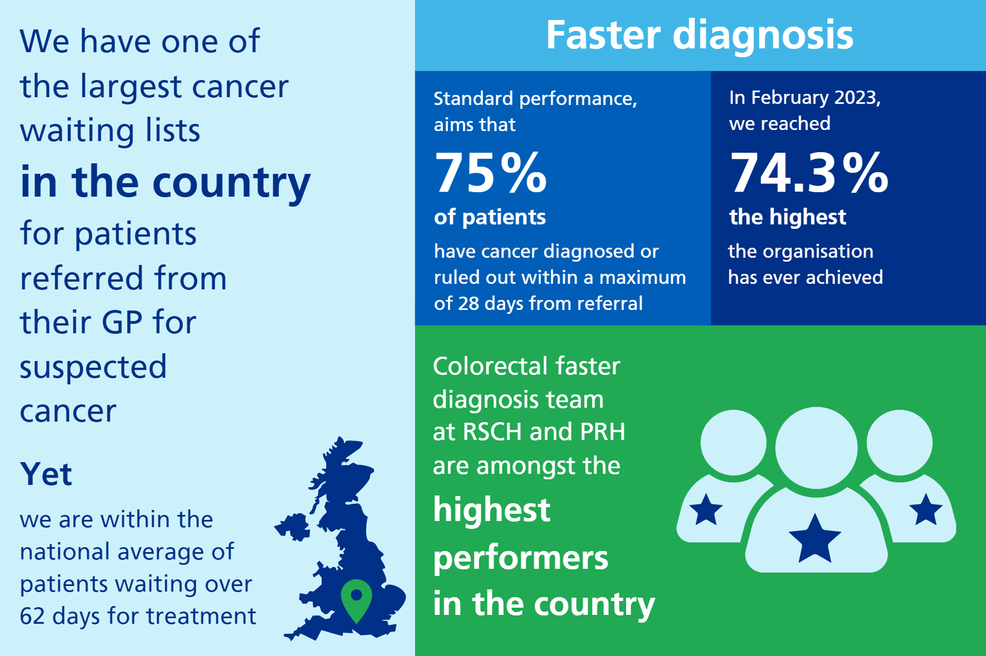
Improving cancer care
Aim
Maintain progress and move towards meeting national 62-day cancer target by March 2024
Notes:
We have one of the largest waiting lists in the country for patients referred from their GP for suspected cancer. Despite this, we are within the national average of patients waiting over 62 days for treatment.
We had an extremely strong finish to the financial year in terms of Faster Diagnosis Standard performance, which aims that 75% of patients have cancer diagnosed or ruled out within a maximum of 28 days from referral.
In February 2023, we reached 74.3% - the highest the organisation has ever achieved.
Certain tumour sites, such as the colorectal faster diagnosis team at RSCH and PRH are amongst the highest performers in the country
Look ahead:
Our focus now is to maintain this progress and move towards 62-day compliance, which we will aim to achieve by March 2024.

Slide 8
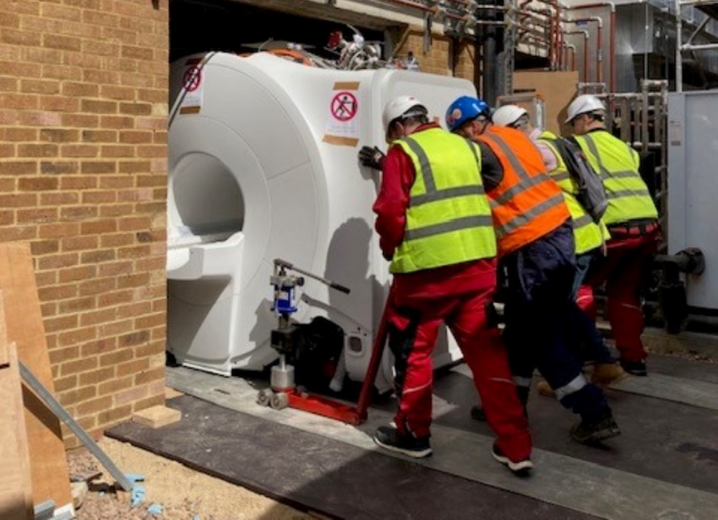
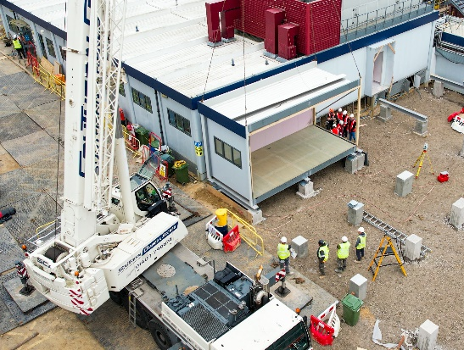
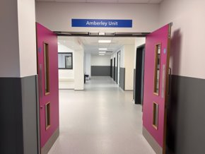
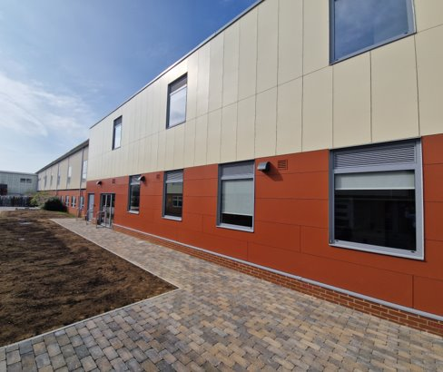

Investing in our future
£120 million
We invested nearly £120m in modernising our hospitals last year
Community Diagnostic Centre (Southlands)
Urology Investigation Unit
(Princess Royal)
Medical Day Case Unit
(Worthing)
Laundry Department
(St Richard’s)
Notes:
In 2022/23, we invested nearly £120 million in modernising our hospitals.
The most high-profile investment is our new Louisa Martindale Building at the Royal Sussex County Hospital site.
Also a new Community Diagnostics Centre at Southlands Hospital in Shoreham-by-Sea is nearing completion, offering quicker and more local access to MRI and CT scanners, as well as a host of other diagnostic specialist equipment and expertise.
At St Richard’s Hospital in Chichester, we invested £7 million in the laundry department to develop one of the most advanced and environmentally sustainable facilities in the NHS.
In Worthing Hospital, a £7 million redevelopment of the Medical Day Case Unit was reopened as The Amberley Unit, our new home to chemotherapy and medical day services for cancer patients.
At Princess Royal, a new £8 million Urology Investigation and Treatment Centre (UITC) is taking shape, which once open later this year will double capacity for the service in Haywards Heath.

Slide 9
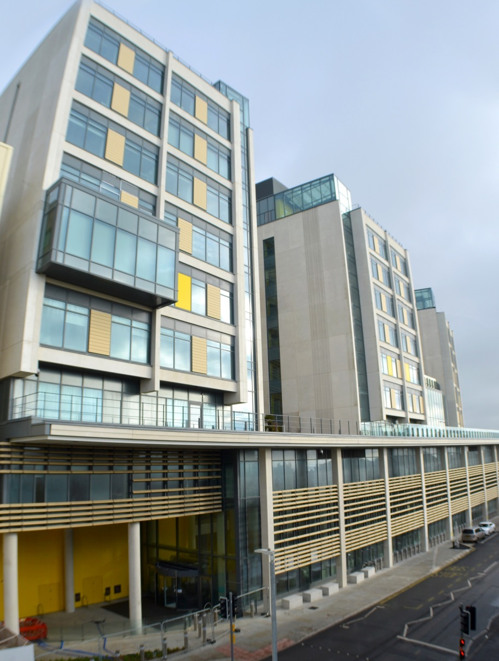
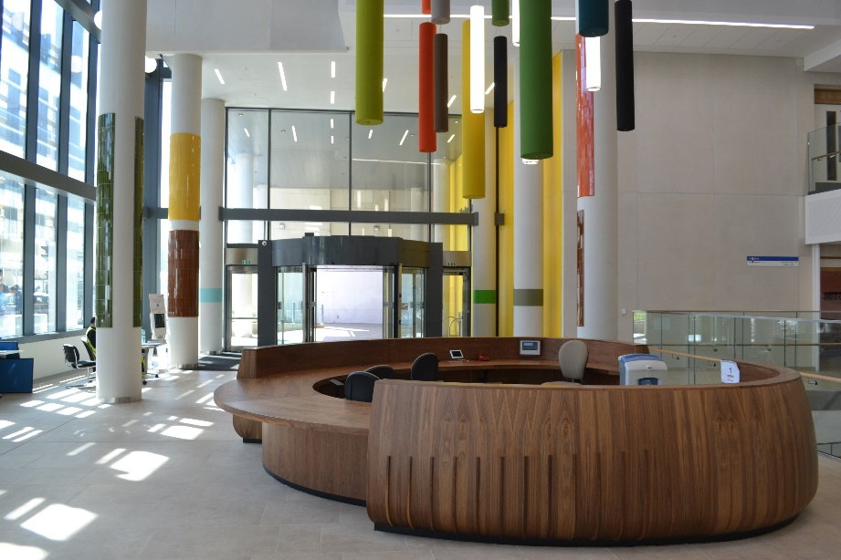
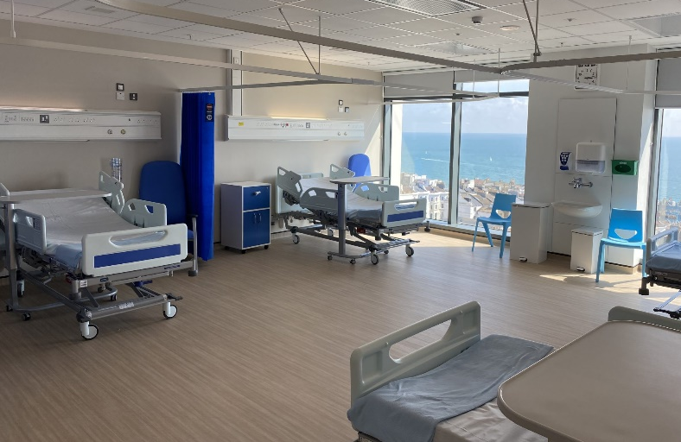
Louisa Martindale Building completion
£500 million
New home for nearly 30 wards and departments
State of the art facilities
Outpatients, wards, theatres and specialist services
Modern spacious design
65% of ward beds are in single rooms - remainder 4-bed bays
The Welcome Space
New main entrance for Royal Sussex County Hospital
Notes:
redevelopment programme and can tell you more about some of these….”
Co-location
New pathways
New MDTs
Teaching and training facilities
Brand new equipment
Better access to rest of estate, such as A&E and reducing admission times etc
Better discharge planning

Slide 10
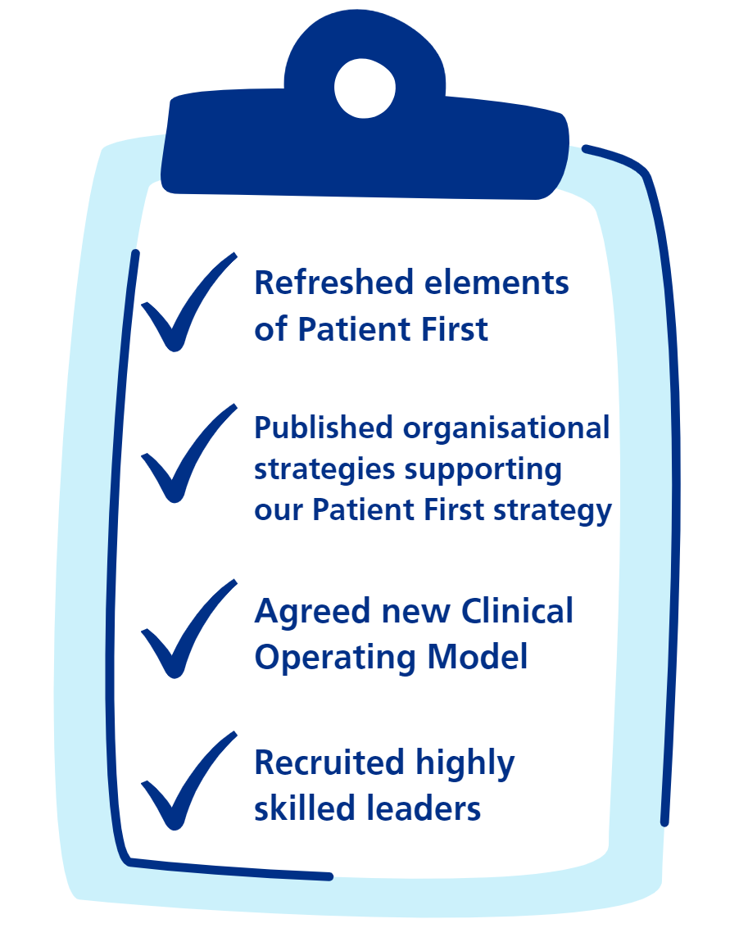
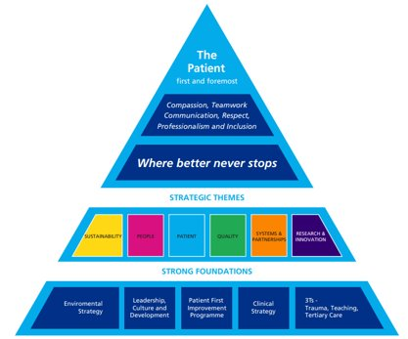
Further improvements
Notes:
We refreshed our Patient First improvement strategy to focus on the priorities we know will make the most meaningful difference to our patients. New breakthrough objectives and added R&I
We agreed our new Clinical and Corporate Operating Models to give us the right divisional and hospital leadership structures to get the best out of our new organisation.
And we have recruited highly skilled and experienced leaders we need from both within and outside of our Trust to see our hospitals thrive and improve.
This means that the fundamentals are now in place to enable us to make swift progress and continually improve the care and quality of services our patients experience and should expect from UHSussex.
This means we are now set up for success.
It takes highly motivated and engaged people to provide that excellent care every time
Being clear about our purpose and our commitment to it is really important when things are as challenging as they are right now and we’re asking people to go above and beyond for their patients and each other.
I’m always struck by the willingness of colleagues to do that, and I know the people whose lives you save and improve are immensely grateful for it.
That sense of purpose underpins all the great work that is going on across our hospitals.
Thank you again for your commitment to it.

Slide 11
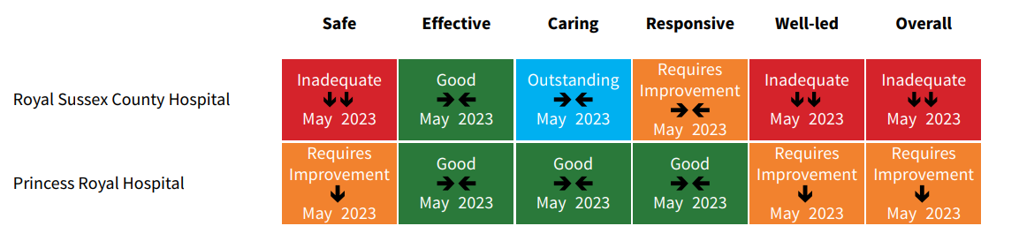

CQC inspections focused on RSCH
Royal Sussex County Hospital
Surgery (main theatres) re-inspection - April 2022
Urgent and Emergency Services - April 2022
Gastro-Intestinal Surgery and
Cancer Care unannounced inspection August 2022
Neurosurgery - unannounced inspection - October 2022
Trust-wide
Maternity (Inpatient services) re-inspection - April 2022
Well led inspection - October 2023
CQC report was published May 2023

Slide 12
Looking ahead with Patient First strategy
Patient Vision Excellent care every time Breakthrough Clear communication | Sustainability Vision Making the most of our resources Breakthrough Improving productivity | People Vision A great place to work Breakthrough Staff voices count
Quality Vision Best outcomes Breakthrough Fewer falls | Earlier intervention | Systems & Partnerships Vision Accessible care Breakthrough Home for lunch | Research & Innovation Vision Evidence-based improvement Breakthrough Taking part

Slide 13

Find out more in our Annual Report
Notes:
Search Annual Report in Resources section of website – found in top menu, after Contact, About us, News, then Resources

Slide 14


Become a member or support our charity
Join us as a member
Free membership
NHS Discounts
Member’s newsletter
Support our charity
My University Hospitals Sussex charity launched to raise funding to support treatment, care and research that goes over and above core NHS funding that makes a real difference to patients and staff

Slide 15

VIDEO – Review of the Year 2022/23
Notes:
Before I take questions, I’d just like to share a brief video that highlights some of the many achievements across UHSussex that took place last year – I hope you enjoy it….

Slide 16

Any questions?

Slide 17


Slide 18
University Hospitals Sussex NHS Foundation Trust
2022/23 Financial Report to the AGM
Karen Geoghegan
Chief Financial Officer

Slide 19


Finance - emerging from the Pandemic
At the start of 2022/23, the Trust was beginning to come out of two of the most challenging years in the history of the NHS.
              The Covid-19 vaccine roll-out programme had been in operation for over a year but consequences of the virus still presenting significant operational challenges
It was clear that Covid -19 prevalence, would be something we would need to monitor and flexing our responses to the emergence of new variants was rapidly becoming a routine process.
Thoughts turned more firmly to restoring services, which led to a
requirement for clarity and certainty of approach, namely through making
inroads to returning to pre-pandemic priorities and financial arrangements.

Slide 20



Another new Financial Framework …..
The NHS moved beyond the initial immediate response and
emergency payment arrangements ceased. The transition back
towards local contracts under the National Tariff Payment
System began.
For 2022/23, a simplified payments system remained in place ensuring that
resources could be optimally focused on operational priorities.
Fixed funding envelopes were revised and supplemented with additional funds for maternity services and growth, alongside funding for excess inflation costs.
With a return towards pre-pandemic financial planning, efficiency requirements
were a national requirement and COVID funding was reduced by 57% (£22m).
          The Trust’s Efficiency requirement was £47.7m (3.7%)

Slide 21

Finance 2022/23 – The challenge
Entering 2022/23 the Trust’s financial plans reflected:
    High inflation costs,
    Increased efficiency requirements,
    Reduced COVID funding,
    High vacancy levels,
    Uncertainty of COVID - 19 transmission and prevalence,
    Increased reliance on agency and locum staff.
Operational and Financial Planning guidance set out the intentions for the year ahead.
In 2022/23 Trust responded to the challenges of restoring services, meeting the new care demands and reducing treatment backlogs that are a direct consequence of the pandemic, through:
  Accelerating plans to grow the substantive workforce and work differently - focussing on the health, wellbeing and safety of our staff,
  Learning from Pandemic ways of working to exploit the full potential of digital technologies,
  Working in partnership as Systems to make the most effective use of the resources available, to get above pre-pandemic levels of productivity.
  Increase capacity and invest in our buildings and equipment to support staff to deliver safe, effective and efficient care.
  Balancing these “asks” amid operational pressures, exacerbated by Industrial action, and the constrained financial envelope available, set the backdrop for the 2022/23 financial year.
This was also only our second year as a merged Trust!

Slide 22
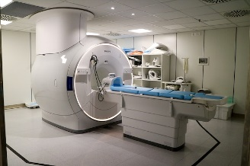
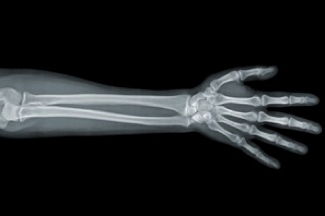

Achievements 22/23
Delivered agreed ICB financial target under challenging operational circumstances.
Delivered capital plan of £117.6m in full.
Achieved delivery of £42m of Efficiency schemes.
Learned and applied multiple national frameworks and secured £27m additional funding to support elective restoration and recovery.
Successfully secured new investment for Community Diagnostic Centre
at Southlands and ED Development in Brighton.
Completed Finance Team reconfiguration post-merger
Fully audited accounts delivered ahead of submission
deadline.
2022/23 Financial Report to the AGM

Slide 23
Challenges to delivery of the financial plan
2022/23 was a challenging year financially with a number of key drivers:
Inflation – post pandemic there were significant increases in the price of goods, in particular utilities, that were in excess of both funding assumptions and allocations (£7m)
Mental Health Patient Specialling – there were also significant increases in costs related the care of Mental Health patients, linked to both an increase in the number of patients in our Emergency Departments and patient acuity (£8m)
Urgent care capacity – there was an increase in both the number of patients, including those who are medically ready for discharge and awaiting onward care, and a requirement to open additional beds in excess of the funding available (£8m)
2022/23 Financial Report to the AGM

Slide 24
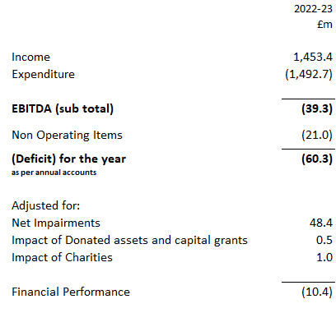
UHSussex Income and Expenditure
Account 2022/23 - Audited Accounts
The Trust delivered an adjusted financial performance of £10.4m deficit achieving the revised target agreed with the Sussex Integrated Care System (ICS).
Efficiency improvements of £42.0m were delivered and £117.6m of capital investments in infrastructure and equipment were made.

Slide 25
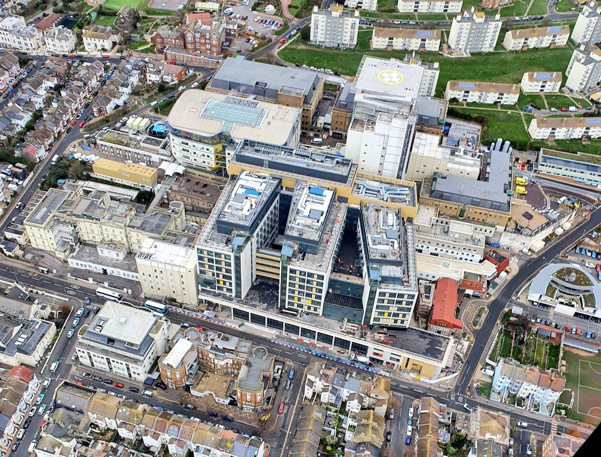
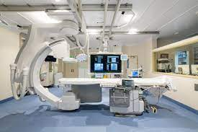
Capital Investments 2022/23
  During the year the Trust delivered 258 individual investments totalling £117.6m. The table below details key areas of investment.

Slide 26

Our Auditors’ views
External Audit (Grant Thornton)
The Auditor opinion confirms that that the financial statements:
Give a true and fair view of the financial position of the Trust; and
Have been prepared properly in accordance with the appropriate legislation and guidance; and
In the assessment of the risk of significant weakness in the Trusts’ Value for Money arrangements, the auditor reports significant weakness identified in our quality governance arrangements.
Internal Audit (BDO)
Overall, the auditors were able to provide moderate assurance that there is a sound system of internal control, designed to meet the Trusts’ objectives and that controls are being applied consistently.

Slide 27

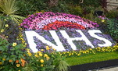

Looking forwards….2023/24
Planning and Contracting – return to “normal” processes.
Focus on elective recovery and waiting list reduction – 65 week waits.
Another challenging financial break-even target.
  COVID-19 – 75% reduction in funding.
  £62m efficiency programme (4.0%).
£100m capital investment programme.
Opening of Louisa Martindale Building June 23!
Opening of Community Diagnostic Centre Sept 23!
Redesign of Emergency Department at Brighton.
Our key challenges:
  Elective activity requirements.
  Urgent and emergency care pressures.
  Industrial action.
  Inflationary pressures.
  Workforce constraints.

Slide 29
COUNCIL OF GOVENORS MEETING
Tuesday 25 July 2023

Slide 30
2022/23 Annual Audit
Presentation to the UH Sussex Council of Governors
July 2023

Slide 31
External Audit Scope of work
 | Outcome
Opinion on the financial statements | Unqualified
Financial Statements - other responsibilities under the Code | No issues to report
Value for money assessment | significant weakness identified
Statutory duties | Not exercised

Slide 32
Financial accounts audit
Materiality – Trust £21.9m
Areas of audit risk
  Management override (mandatory risk under auditing standards)
  Improper revenue recognition (mandatory risk under auditing standards)
  Valuation of land and buildings
  Implementation of IFRS 16 – leases
  Findings
    High quality draft Statement of accounts; Good working papers
    One immaterial change made to balance sheet (PPE); disclosure note changes made

Slide 33
Financial statements – other responsibilities under the Code
Responsibility | outcome
Other information | No issues raised
Auditable elements of Remuneration report | No issues raised
Whole of government accounts submission | No issues raised
Certification of closure of the audit | Audit certified 28 June

Slide 34
Value for Money arrangements
Context – NAO framework
  Auditors are required to provide a commentary on the Trust’s arrangements under three headings;
    Financial sustainability
    Governance
    Improving economy efficiency and effectiveness
  Auditors are required to identify any significant weaknesses in arrangements.

Slide 35
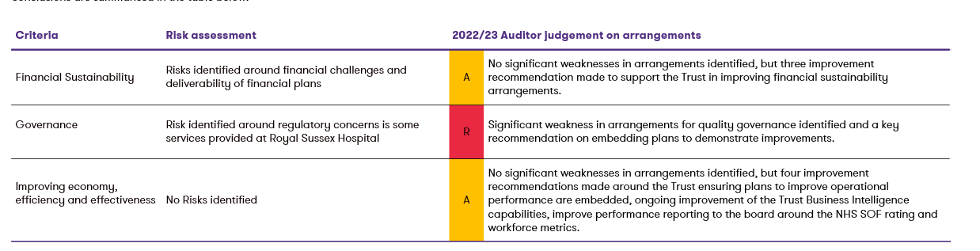
Value for Money arrangements
Summary of findings
 | No significant weaknesses in arrangements identified or improvement recommendation made.
 | No significant weaknesses in arrangements identified, but improvement recommendations made.
 | Significant weaknesses in arrangements identified and key recommendations made.

Slide 36
Value for Money arrangements
Grant Thornton’s NHS client base – 76 bodies – 16 ICBs and 60 trusts
Outcomes
 | Financial sustainability | Governance | 3Es
Significant weaknesses | 20 | 3 | 3
Possible significant weaknesses | 11 | 2 | 0
No significant weaknesses | 45 | 71 | 73

Slide 37
Any Questions?

Slide 38
ACCEPTANCE OF ANNUAL REPORT AND ACCOUNTS
Tuesday 25 July 2023

Slide 39
QUESTIONS FROM GOVENORS
Tuesday 25 July 2023

