Slide 1
Hospital Liaison Group Thursday 26th March 2026
Start: 18:00
Terece Walters
Hospital Nurse Director, RSCH
Liz Cook
Capital Project Manager

Slide 2

AGENDA
March 2026
 | Part One:
18:00 | Hospital Nurse Director Welcome & Introductions | Terece Walters
18:00 | Chair’s Opening Remarks | Terece Walters
18:05 | Minutes of the Previous Meeting | Terece Walters
18:10 | Hospital Operations “You Said, We Did” | Terece Walters
18:20 | Residents Questions on Part 1 | Terece Walters
 | Part Two:
18:30 | Construction Activities - Look Forward | Liz Cook/ Paul Gillen
18:40 | Residents Questions on Part 2 | Liz Cook/ Paul Gillen
18:55 | Any Other Business | Terece Walters
19:00 | Date of Next Meeting (TBC) | Terece Walters

Slide 3
“You Said, We Did”
Terece Walters
Hospital Nurse Director

Slide 4


Operational
YOU SAID, WE DID
March 2026
North Service Road – Proposed Signage Improvements
To support clearer site navigation and reduce inappropriate vehicle access, new signage is requested for installation along the North Service Road. The aim is to make it immediately clear to drivers that the route is not intended for through‑traffic and should not be used as a drop‑off point.
Requested signage wording:
• “Not a through road”
• “No drop‑off”
Next step:
Terece to arrange installation of the signage in the identified locations

Slide 5
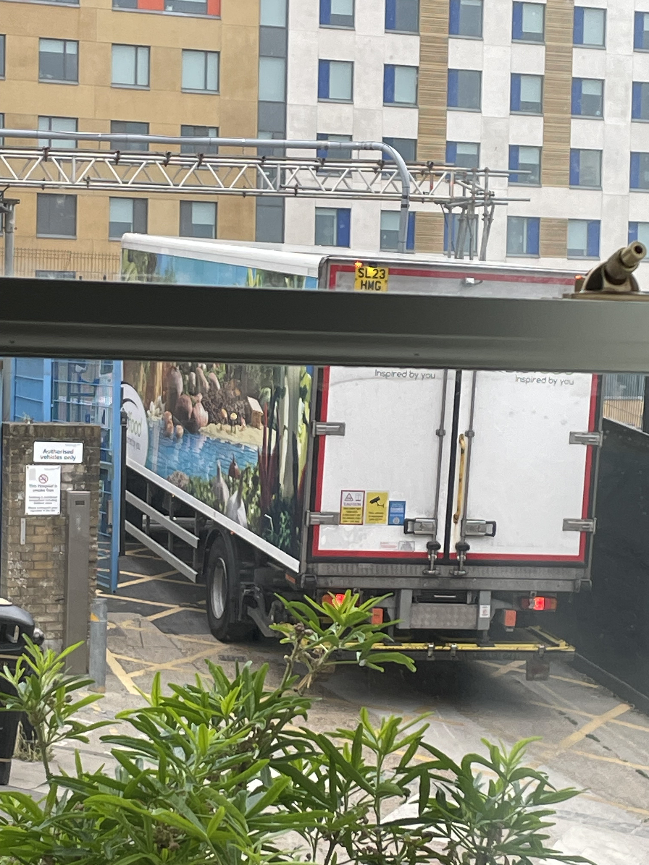
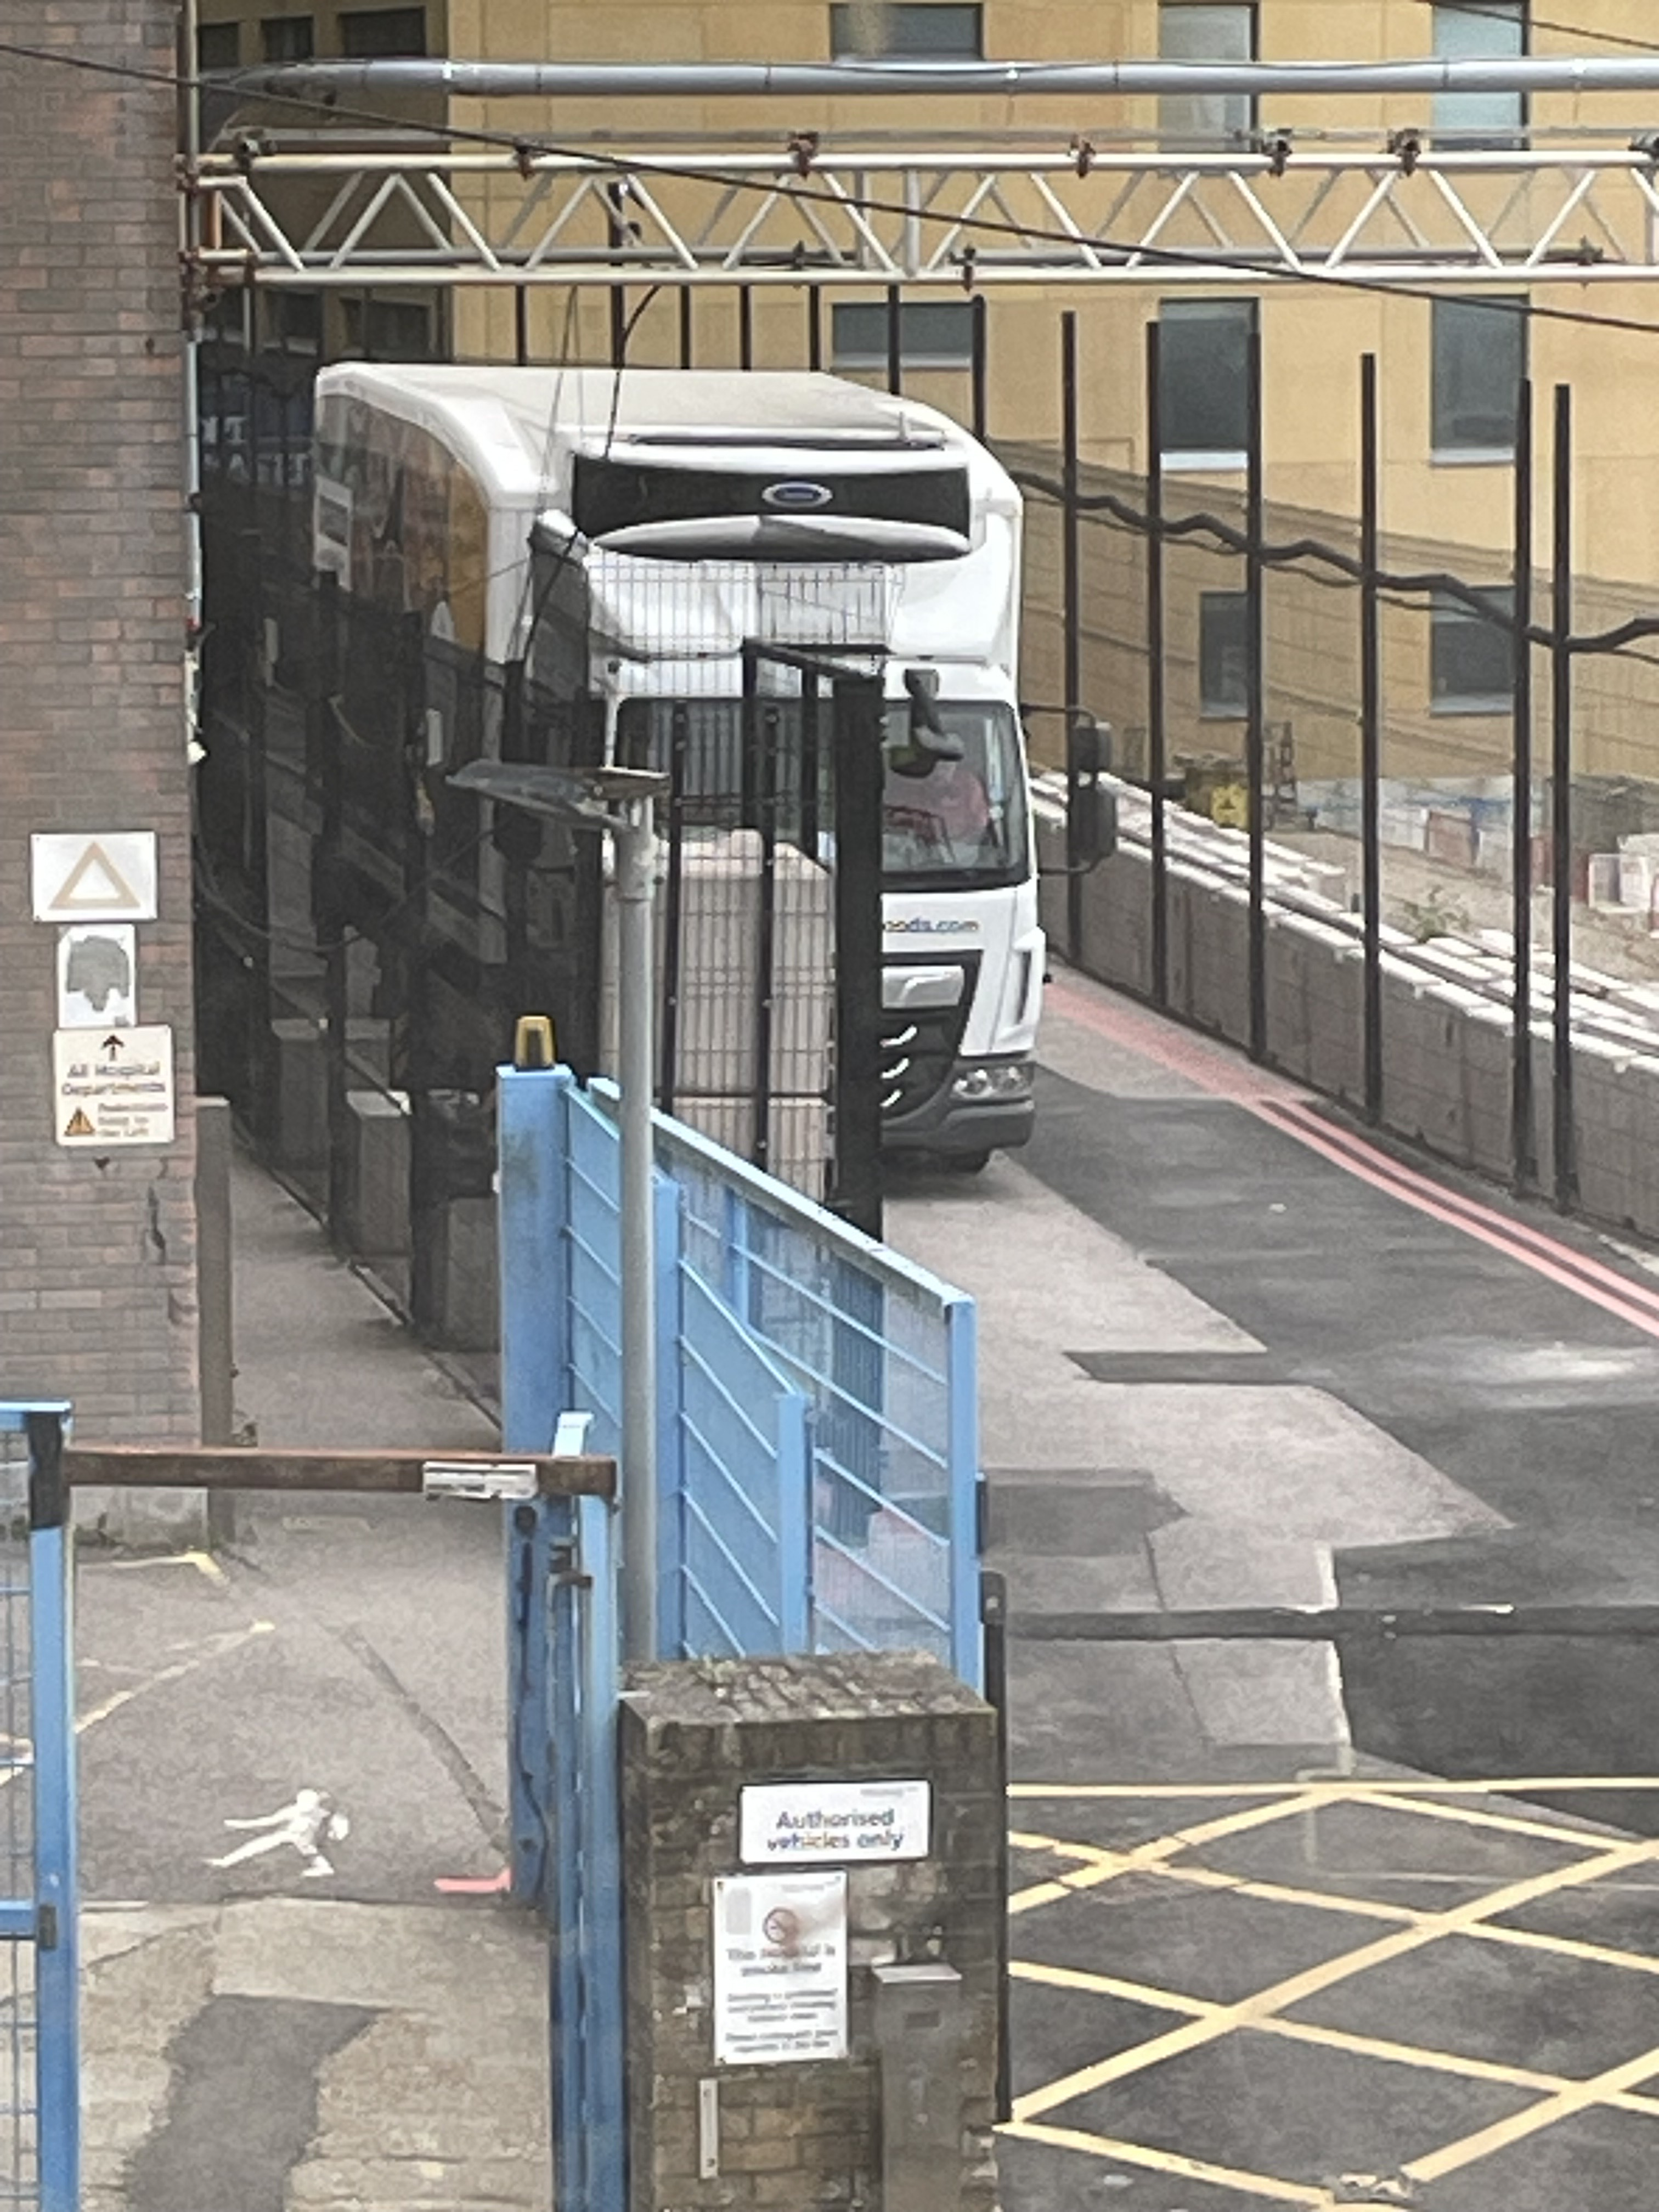
Operational
YOU SAID, WE DID
March 2026
“Bidford and other delivery lorries are reversing into the South Service Road and idling on Upper Abbey road, before 06:30am”
The gate on the Upper Abbey side is operational signage is in place, and no deliveries are accepted via Abbey Road. The gate is installed on Bristol Gate just finishing the IT connection prior to it being made operational

Slide 6
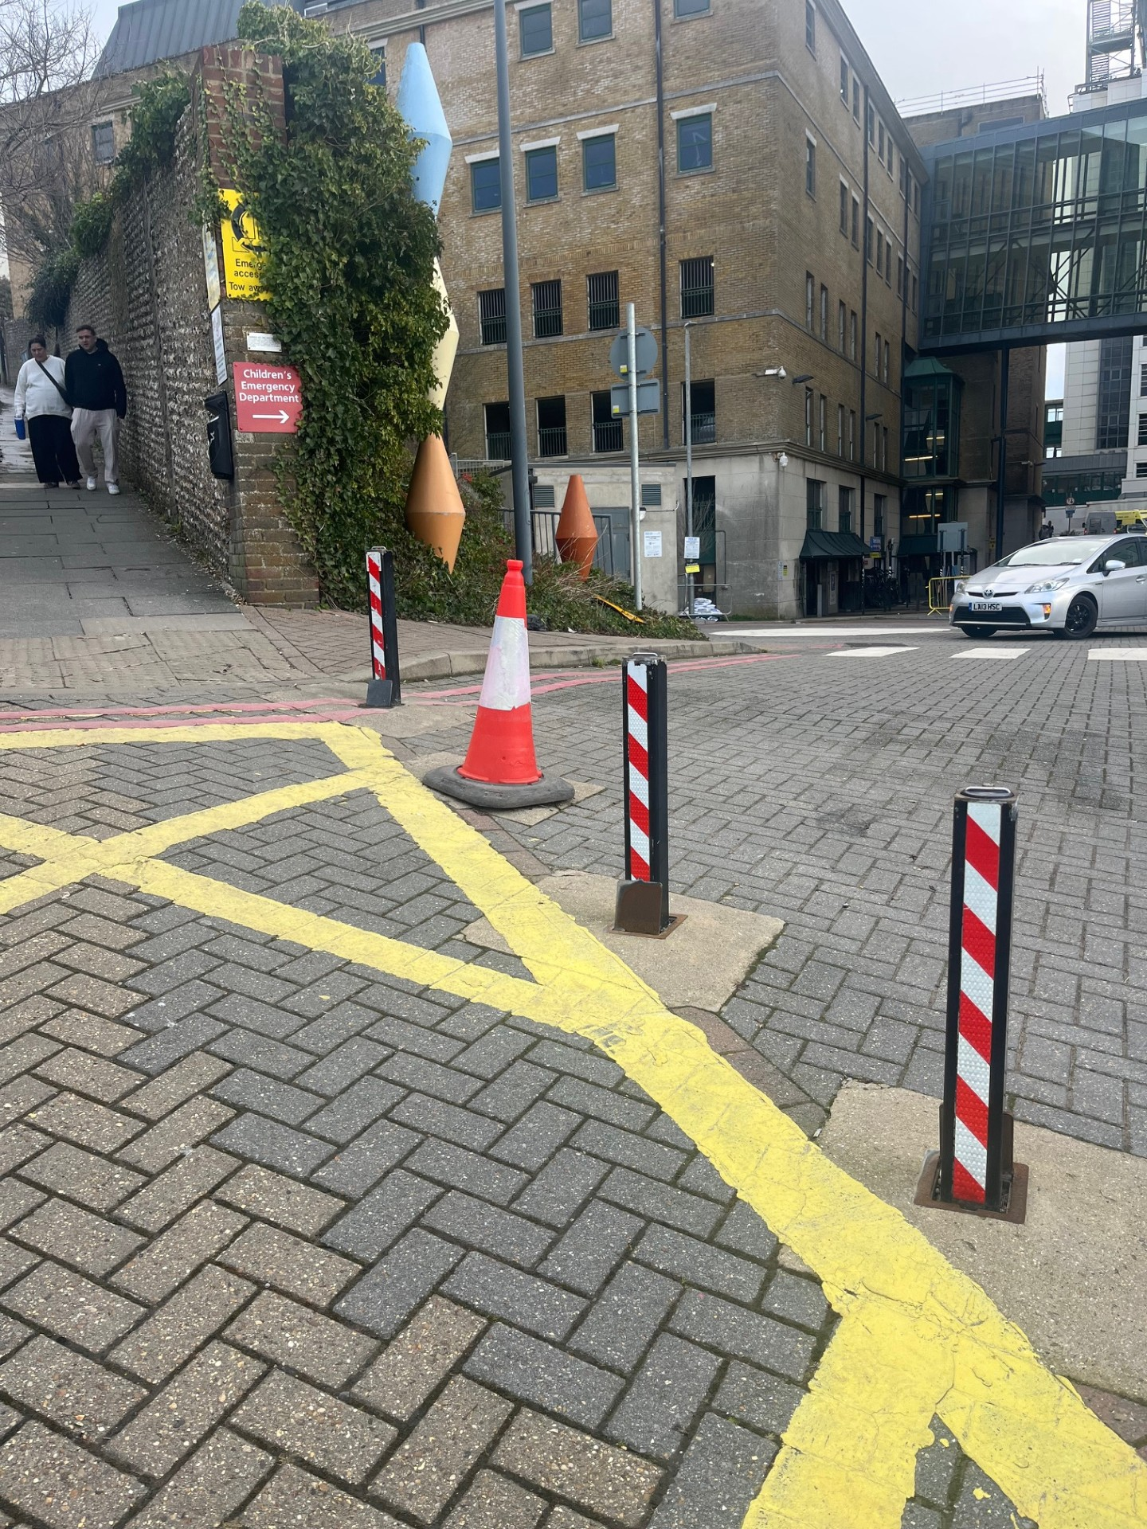
Operational
YOU SAID, WE DID
March 2026
“A bollard at the end of the North Service Road is broken or missing.”
The contractor will be brought back to address this issue as part of upcoming road maintenance.
The road surface near the drains are starting to dip again (previously raised as a concern), these have been inspected and costs obtained looking to undertake work in April.
Bollard has been repaired

Slide 7
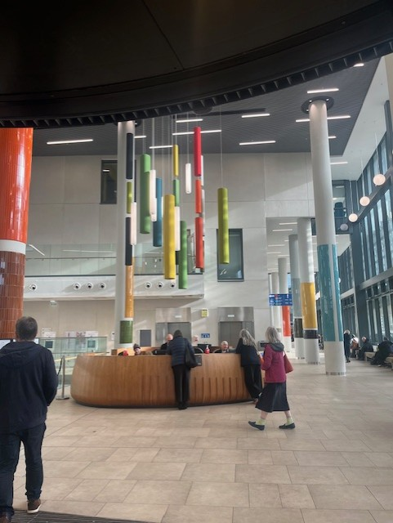

Operational
YOU SAID, WE DID
March 2026
“Despite recent improvements in signage, patients arriving early (around 6:45 AM) still struggle to find Theatre Admissions.”
The team agreed to ask colleagues if an early reception cover can be trialled for a period to see if it improves patient experience. This has not been achieved however signage reviewed and seating provided outside the area

Slide 8
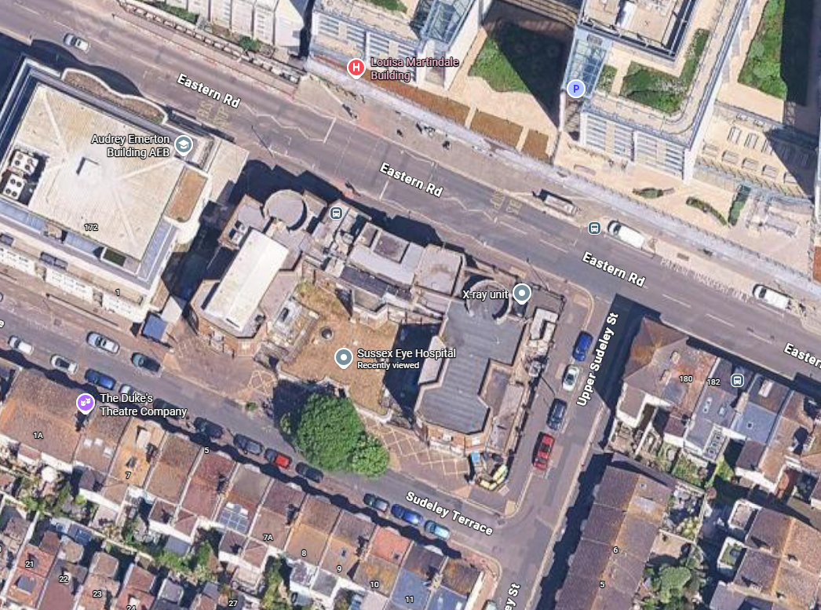
Operational
YOU SAID, WE DID
March 2026
Building Work in Eye Hospital
Fire Escape metal staircases failed an inspection.
Remedial works was needed to the metal stairs this has been completed
We are waiting handrails for flat roof area to be replaced current ones have been made safe in the meantime

Slide 9
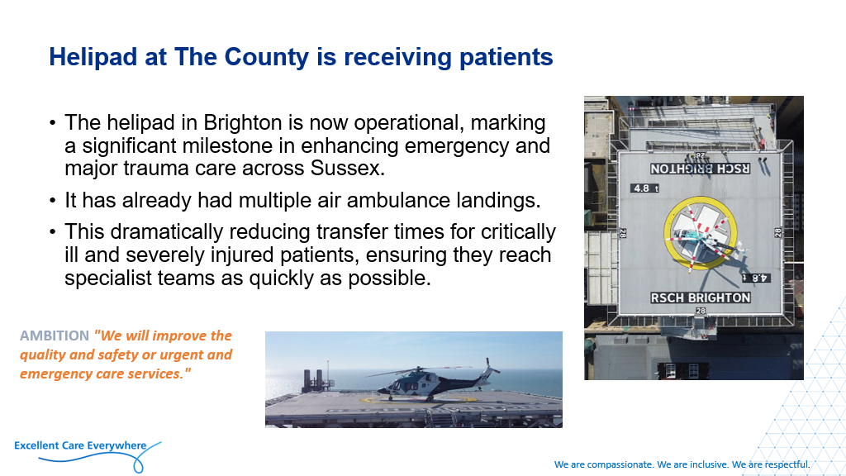
Operational
YOU SAID, WE DID
March 2026

Slide 10
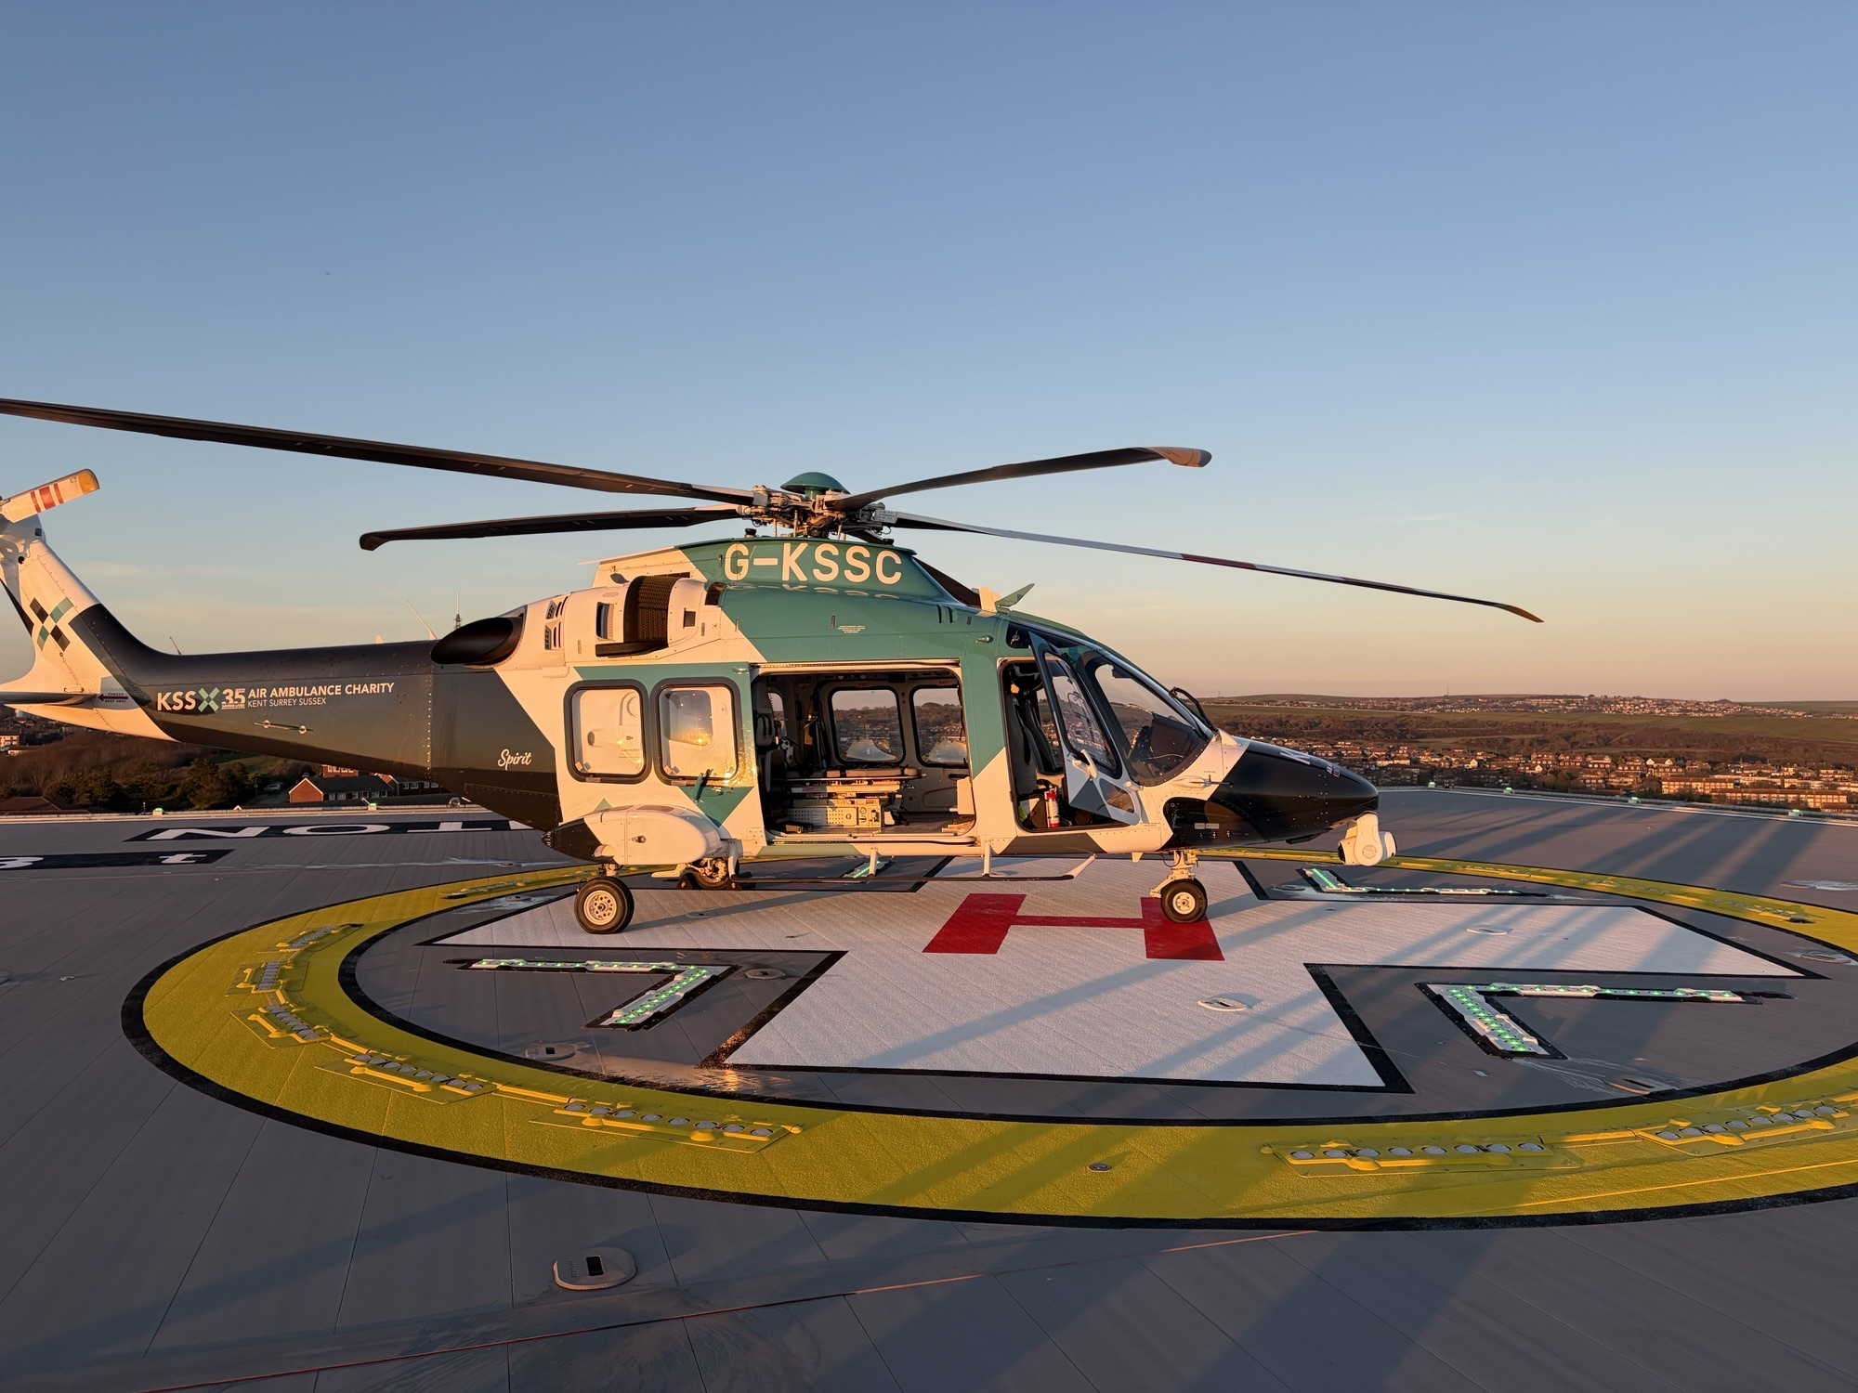
Operational
YOU SAID, WE DID
March 2026
Helipad Landings

Slide 11
Residents Questions on Hospital Operational Matters

Slide 12
Royal Sussex Current Projects

Slide 13
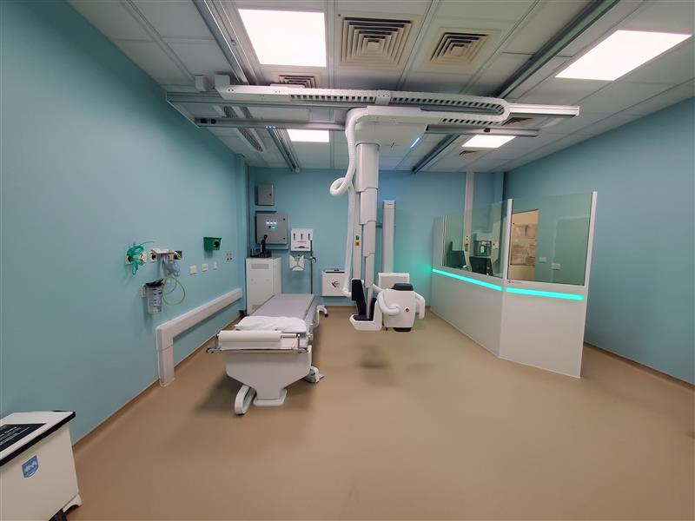
Capital Project Updates
The Acute Medical Unit (AMU) - OPEN
RACH X-Ray replacement​ - Complete
SPEC CT - Installed
Catering Block Refurbishment – Ongoing
TKT Chiller works – Saturday 12th April

Slide 14
Update on construction of the Sussex Cancer Centre

Slide 15
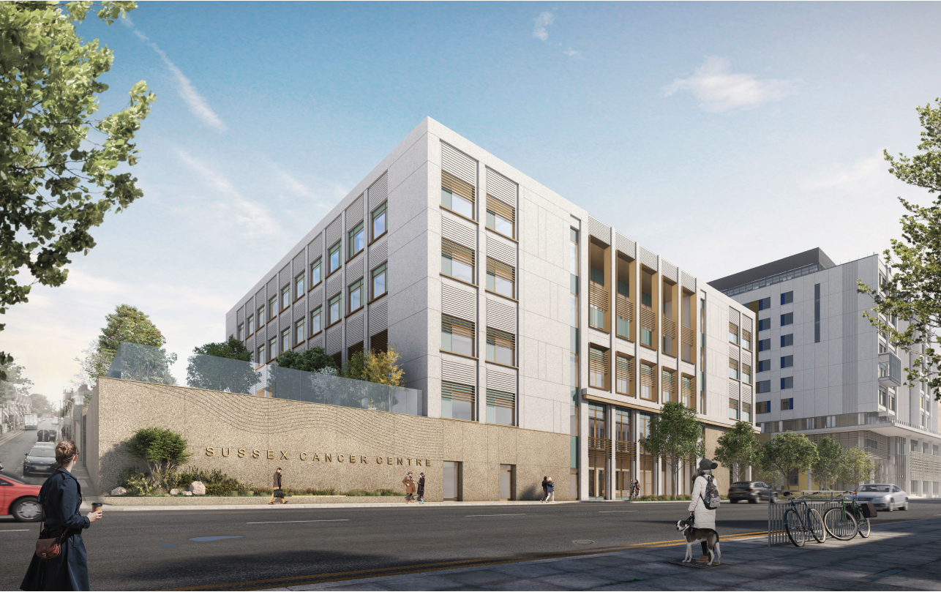
Sussex Cancer Centre
The overall timescales being worked to are:
Enabling works = 2025
Main construction = 2026-2028
Opening to patients = 2029
Offsite manufacture under way
Remobilisation underway, with building foundation works planned to commence 27th April.

Slide 16
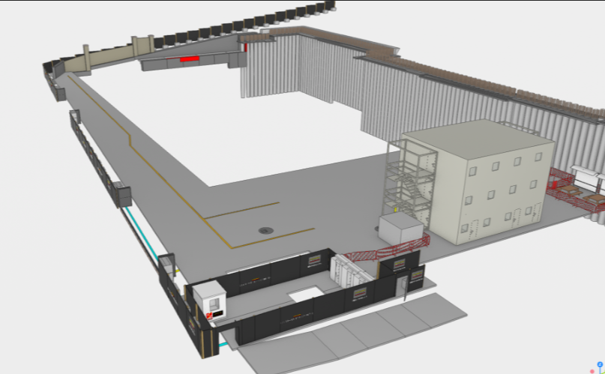
Site Preparations works
Hoarding works
Site Set Up.

Slide 17
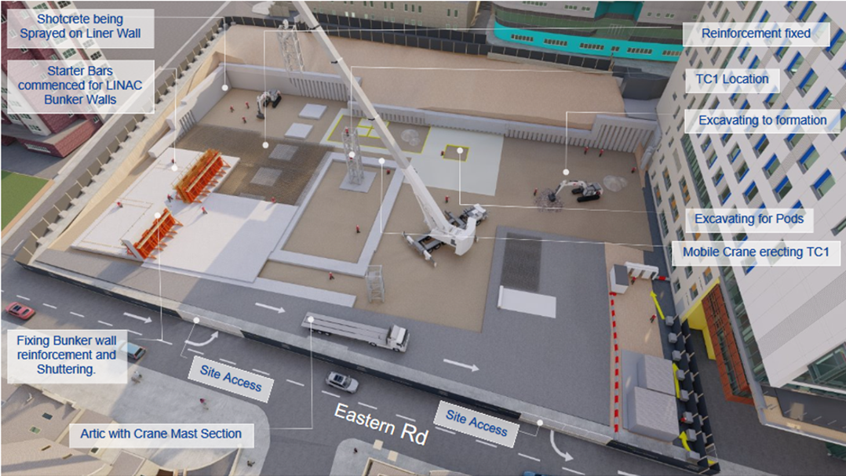
March 2026 Update

Slide 18
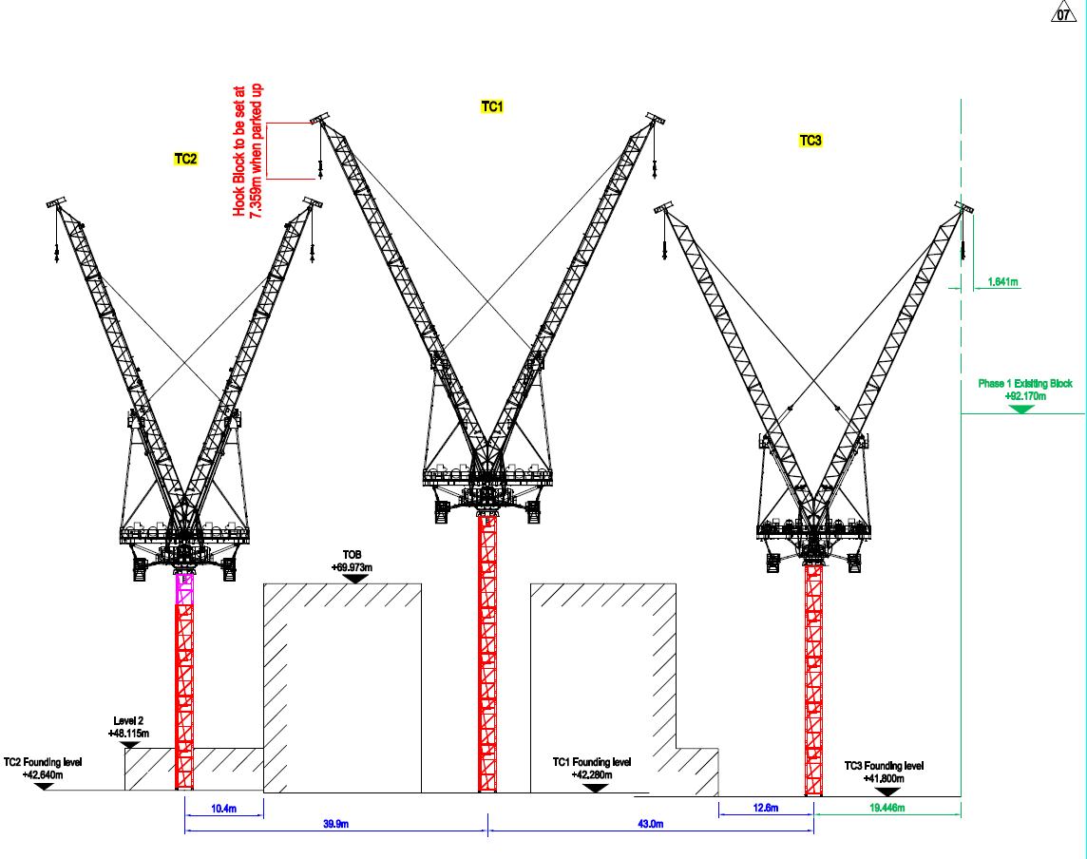

Slide 19
Residents Questions on construction of the Sussex Cancer Centre

Slide 20
Any Other Business

Slide 21
Thank you for coming
Proposed Date of Next Meeting: Thursday 4th June 2026

